Slide 1
Face Mask Detection
MobileNetV2

Slide 2
agenda
About Data
Image pre-processing
Splitting data
Training the model
Testing the model
Result And Discussion

Slide 3
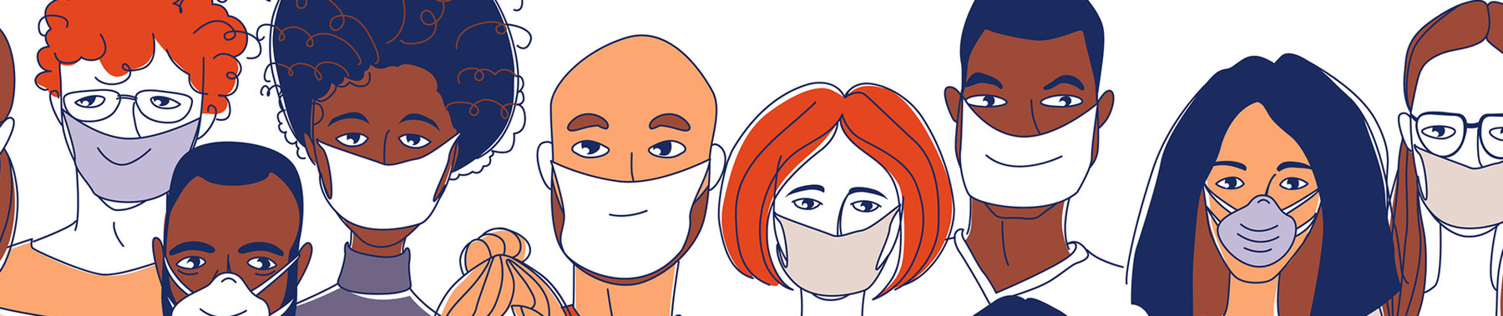
About Data
Sample labelled images (mask, no mask) taken from the dataset for training
and testing​
3725 Images of Face with Mask.
3828 Images of Face without Mask.

Slide 4
Image pre-processing
First step here begins with the iteration through all the images and storing the labels.
resized to 224 x 224 x 3 image which is our standard image size.
the image is converted to a NumPy array.

Slide 5
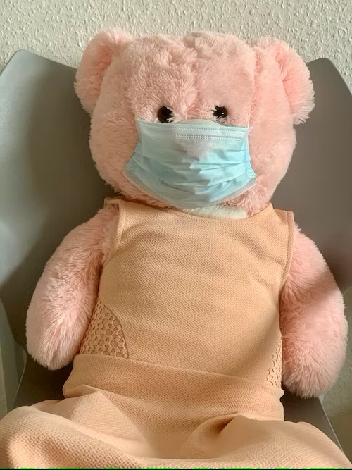
Splitting data
The data was split into two collections, which are training data 80%, and 20 % is testing data. Each collection consists of all the with-mask, without- mask

Slide 6
Training the model
Iterate through all the images and
Store the labels of each image (without mask/ with mask).
Convert image to array and preprocess the image.
Append the image to data.
Convert data and labels to a NumPy array.
Transform multiclass levels to binary levels using labelBinarizer.

Slide 7
Training the model cont.
Split the training and testing data. (20% data is used in testing and 80% data is used in training).
Create instantiation of mobilenetv2 model and remove the last layer.
Add Average pooling 2D, Flatten, Dense (with relu activation), Dropout and Dense (with SoftMax activation) layers.
Assign trainable properties of mobile net v2 base model as false.

Slide 8
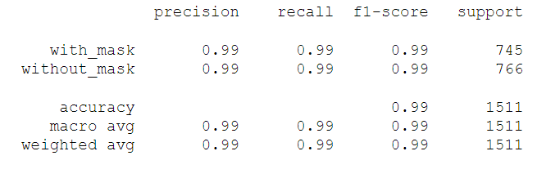
Training the model cont.
Declare learning rate (0.001), epochs(20) and batch size(12).
Use Adam as optimizer and binary cross entropy as loss.
Fit the model.
Save the model.
Test the model with the test splitted data and create classification reports, plots as needed.

Slide 9
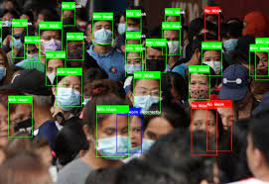
Testing the model
Read photo path and weights path for Open CVV DNN and create a model using the same parameters.
Load the saved trained model.
Use blob from image to preprocess image and convert image to the format that has been used by DNN while training the model.
Detect the faces from the model and save the detections.

Slide 10
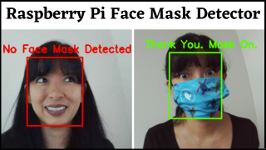
Testing the model cont.
Store the start and end coordinates (both x and y coordinates). Load the saved trained model.
Convert the image to RGB channel and resize, convert to array, and preprocess the image.
Predict the probability of with and without mask using the model loaded initially (our trained model).
Draw a rectangle surrounding the face and put text as “Mask” in green color if mask put text as “Without mask” in red color.

Slide 11
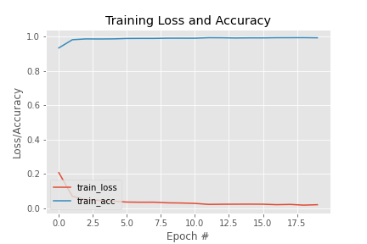
Result And Discussion
The result for 20 iterations in checking the loss=0.0213 , accuracy= 0.9922.
Model Evaluation in table shown:

Slide 12
Thank You

